Slide 1

European Initiative
for the exchange of young officers inspired by Erasmus
The Initiative
Erasmus
Militaire
Military
Erasmus
EMILYO

Slide 2
Contents of the Briefing
General remarks
How & why…. | the Initiative began?
Who …. | is involved in the Initiative?
What …. | are we doing?
Cui bono? | Who benefits what?
Future …. | developments
Report …. | about last EUMACS
Kind …. | requests

Slide 3
Aim of the Briefing
Information about the work of the
Implementation Group (IG)
“European Initiative for the exchange of young officers inspired by Erasmus”
during the study year 2022 / 2023.
Way ahead (based on your decisions).
Some (few) kind requests.

Slide 4

General Remarks
Source: https://www.istockphoto.com/de/vektor/sprechblasen-mit-text-dank-in-verschiedenen-sprachen-gm1322616206-408528126. [1-11-23].

Slide 5
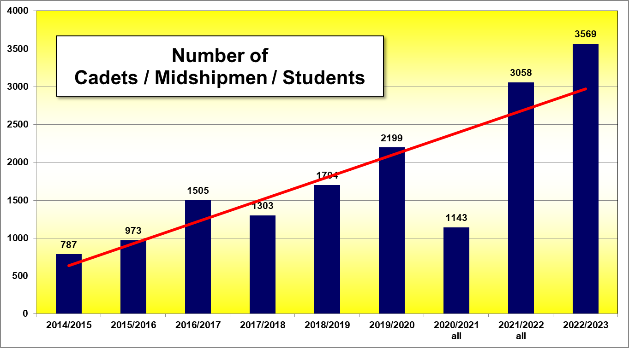
Study Year 2022/2023
Events under the Umbrella of / connected to the IG
trendline

Slide 6
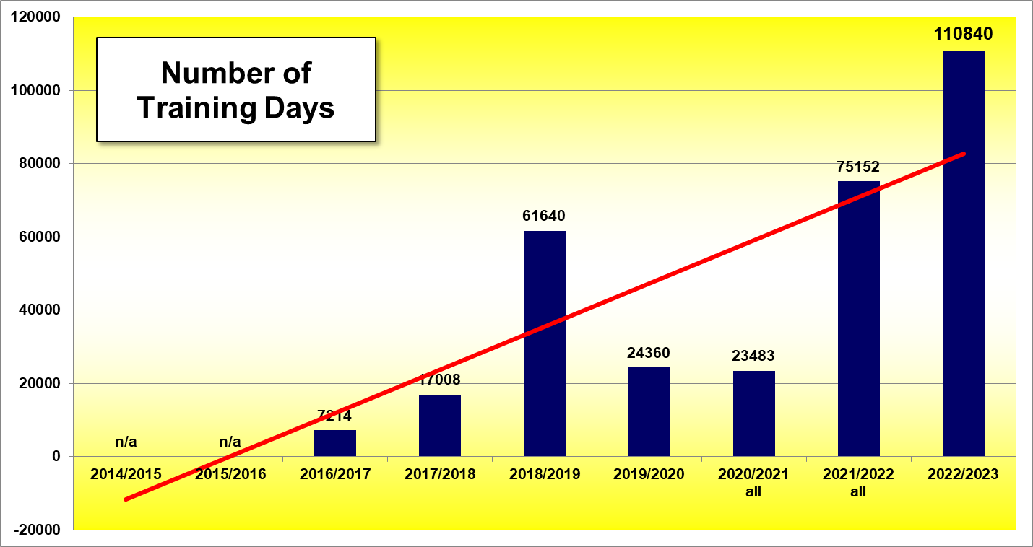
Study Year 2022/2023
Events under the Umbrella of / connected to the IG
Corona

Slide 7
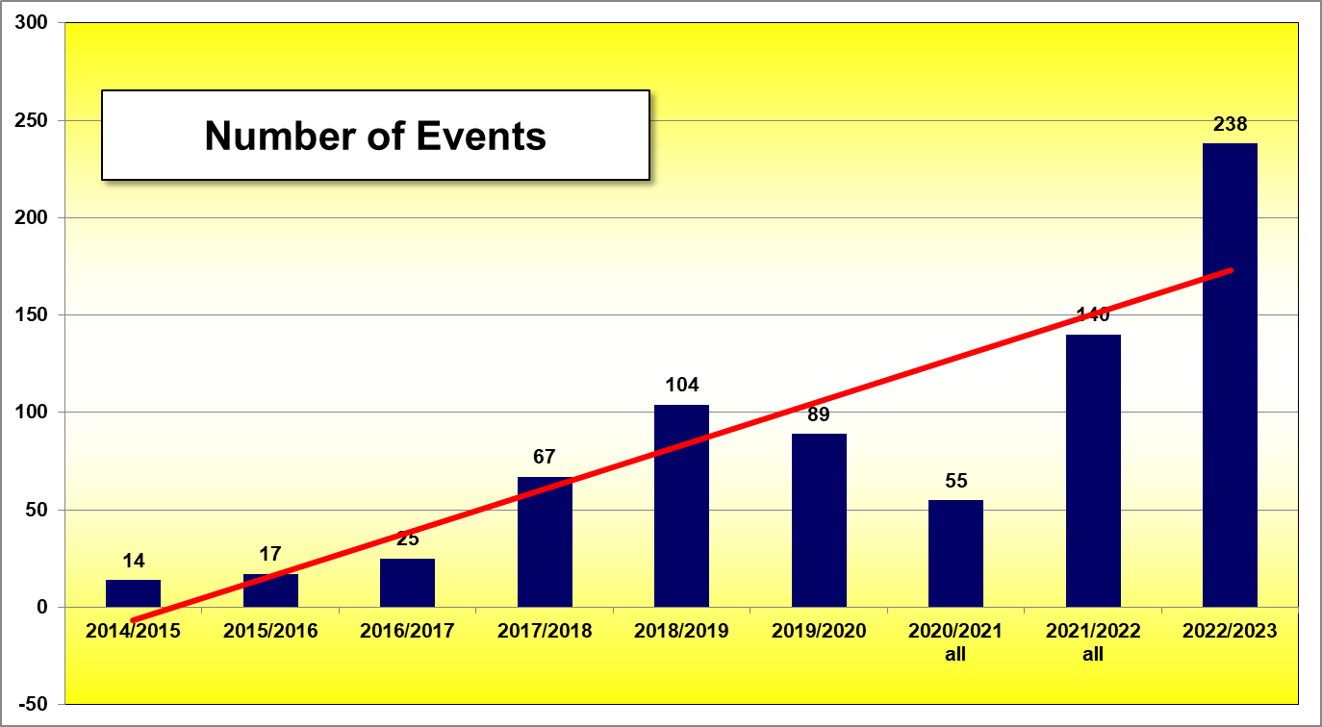
Study Year 2022/2023
Events under the Umbrella of / connected to the IG

Slide 8
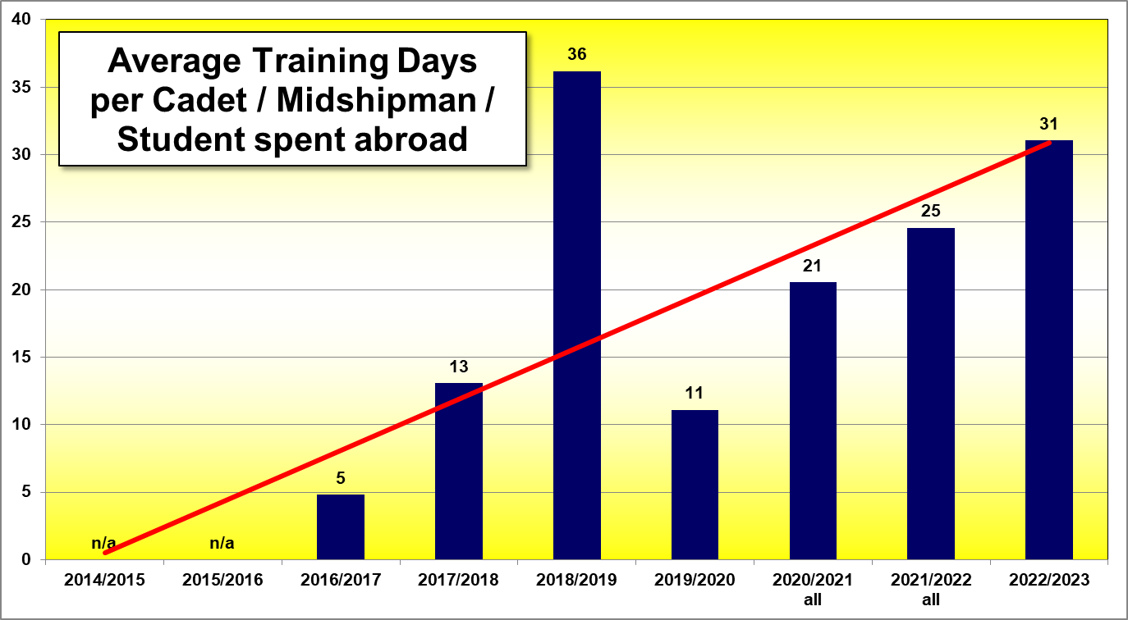
Study Year 2022/2023
Events under the Umbrella of / connected to the IG

Slide 9
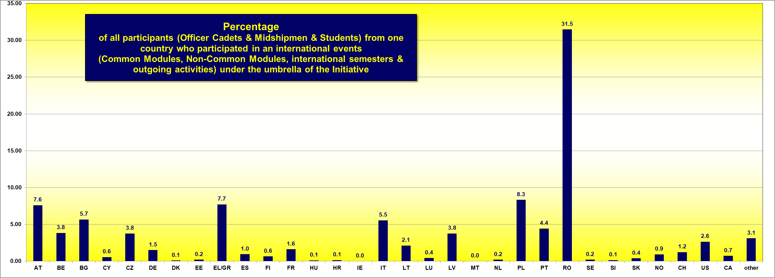
Study Year 2022/2023
Events under the Umbrella of / connected to the IG

Slide 10
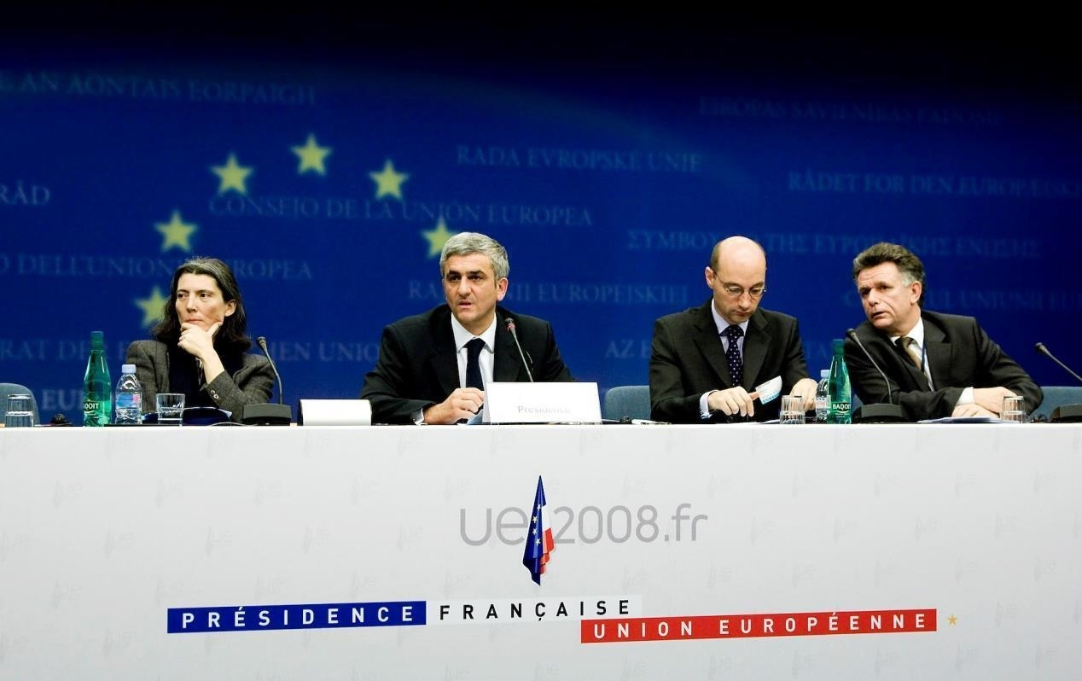
How it began (Nov. 2008)
➔ Declaration of EU MoDs
Establish an Implementation Group (IG) for the
„European initiative for the exchange of young officers inspired by Erasmus“
Goals: Increase interoperability & “harmonise” EU Basic Officer Education – thus, promote a
“European Security and Defence Culture”
Source: Council of the European Union, Council Conclusions on the ESDP, 2903rd External Relations Council Meeting. Brussels. 10th and 11th November, 2008.

Slide 11
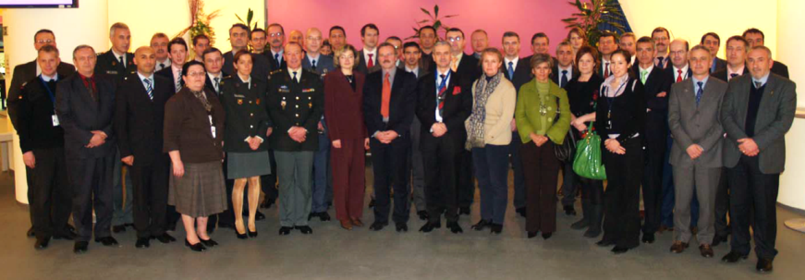
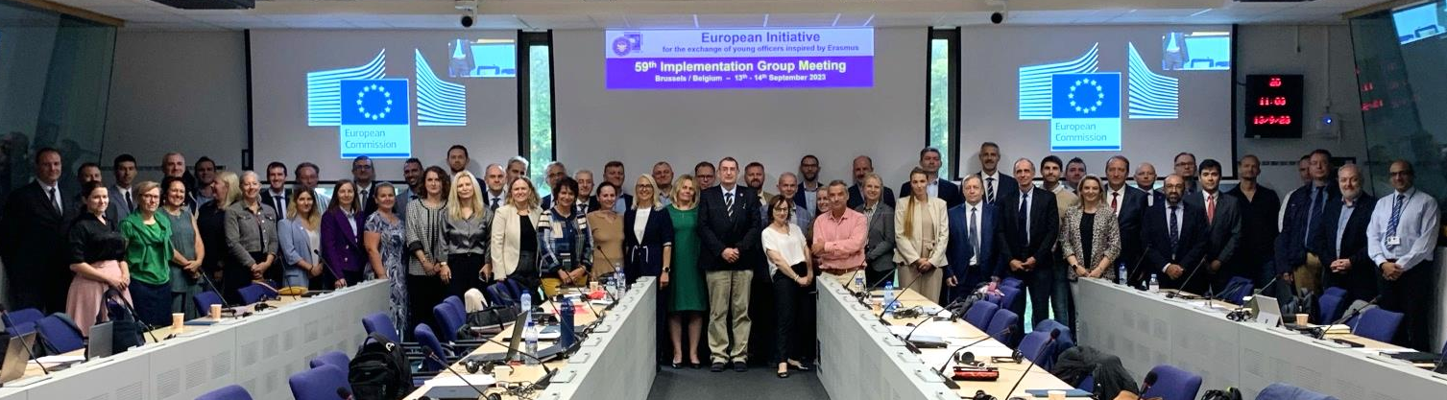
How it began
First & latest Meeting of the Implementation Group
February 2009:
1st IG meeting
Meanwhile
(Sep 2023):
59th IG
meeting
(quarterly
basis)

Slide 12
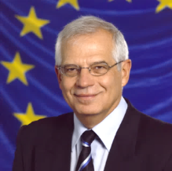
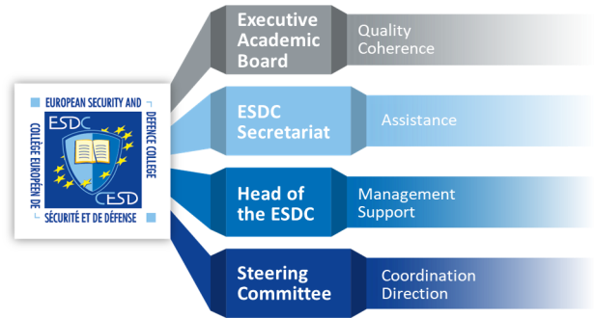
Who is involved in the Initiative
Mr.
Josep
Borrell
HR/VP
European External Action Service (EEAS)
“EU Ministry of Foreign Affairs”
WGMOT
EUMSSF
XY
XY
CMPD
Crisis Management and Planning Directorate
CSDP DocSch
EAB.SSR
EMILYO Implementation Group
Basic Officer Education Institutions’ Representatives
SQF-MILOF EG
EAB.Cyber platform
National Representatives
~ 27 EU Member States + 1 Assoc. Member
~ 65 EU Basic Officer Education Institutions
Army
Air Force
Navy
Technical
Medical
Military Force charged with Police Duties (e.g.: Carabinieri)
Militarised Police Force (e.g.: Guardia di Finanza)

Slide 13
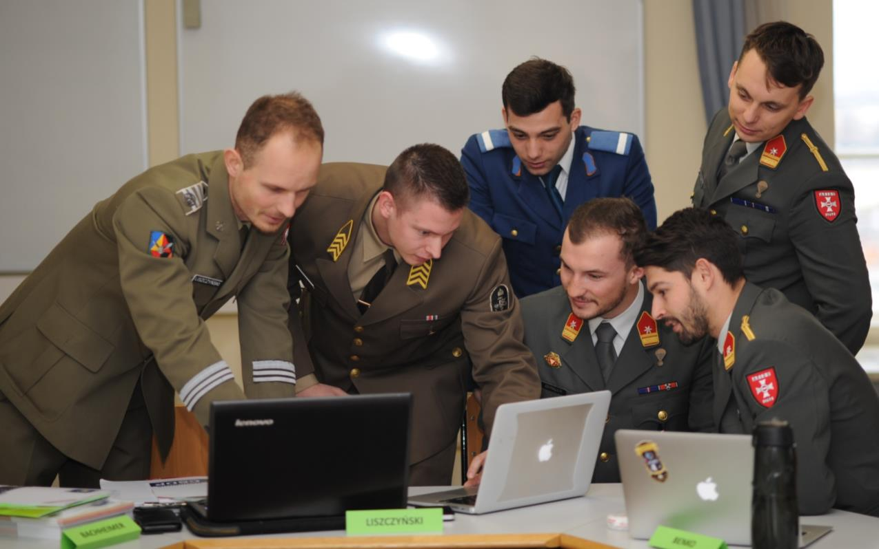

Areas of EMILYO Elaborations
The EMILYO (Military Erasmus) Implementation Group covers both, the …
academic part | AND ⬅➔ | non-academic (vocational) part
of the basic officer education
of all services.

Slide 14
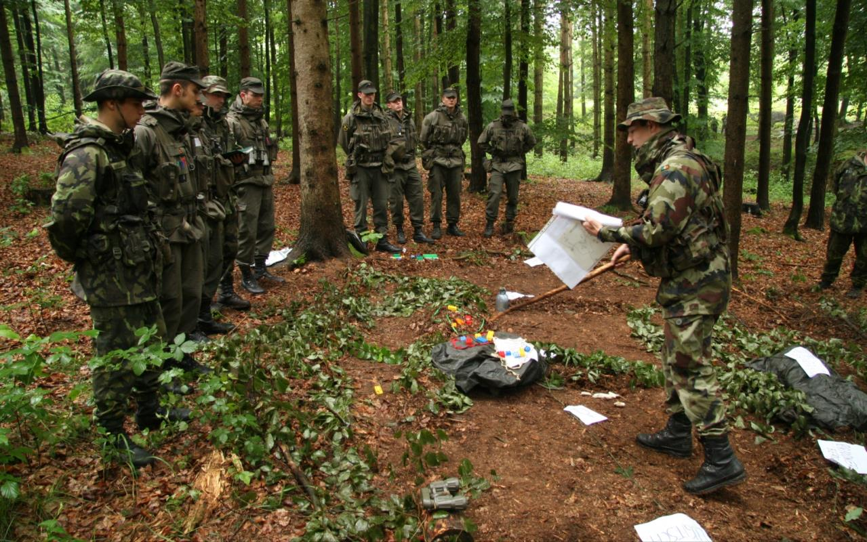
What are we doing?
Lines of Development – Overview
LoD No. | LoD Name | Solved | On-going
1 | System of Equivalences | R
2 | Development of Competences | R | S
3 | Development of IDL/e-learning | R | S
4 | Create an IT-Platform (www.emilyo.eu) | R
5 | (Legal) Framework | R | S
6 | Strategic Communication | R | S
7 | Financing the Initiative | R | S
8 | Common Modules | R | S
9 | Future Projects | R | S
10 | Gender Mainstreaming | R | S
11 | International Naval Semester |  | S
12 | International Air Force Semester | R
13 | International Technical Semester | R | S
14 | Research & Development |  | S
15 | International Medical Semester (frozen)
16 | European Union Military Academy |  | S
17 | International Air Defence Semester |  | S
18 | Language Education & Training |  | S
19 | International Logistics Semester |  | S

Slide 15
What are we doing?
Lines of Development – Chairpersons
No. | LoD Name | Chairperson | BOEI
1 | System of Equivalences | (Col Assoc. Prof. GELL Harald, PhD) | AT-TMA
2 | Development of Competences | Capt (N) Assoc. Prof. DIMITROV Nedko, PhD | BG-NVNA
3 | Development of e-learning | (Col Assoc. Prof. GELL Harald, PhD) | AT-TMA
4 | Create an IT-Platform | (Col Assoc. Prof. GELL Harald, PhD) | AT-TMA
5 | (Legal) Framework | (Col Assoc. Prof. GELL Harald, PhD) | AT-TMA
6 | Strategic Communication | ? Maj TSANAKAS Konstantinos ? | ? GR-HAFA ?
7 | Financing the Initiative | Col MACHADO Paulo, MSc | PT-PMA
8 | Common Modules | Assoc. Prof. KARADIMAS Nikolaos V., PhD | GR-HAA
9 | Future Projects | Assoc. Prof. WINCEWICZ-BOSY Marta, PhD | PL-AWL
10 | Gender Mainstreaming | Col Assoc. Prof. ATANASOVA-KRASTEVA Nevena, PhD | BG-NDU
11 | International Naval Semester | Col Assoc. Prof. POPA Catalin, PhD | RO-RNA
12 | International Air Force Semester | Assist. Prof. KARAMPELAS Panagiotis, PhD | GR-HAFA
13 | International Technical Semester | Col Prof. Eng. MOLDOVEANU Cristian Emil, PhD | RO-MTA
14 | Research & Development | Assoc. Prof. TEMPLALEXIS Ioannis, PhD | GR-HAFA
15 | International Medical Semester | frozen
16 | EU Military Academy (CJS) | (Col Assoc. Prof. GELL Harald, PhD) | AT-TMA
17 | Int’l Air Defence Semester | Col Assoc. Prof. GHERMAN Laurian, PhD | RO-HCAFA
18 | Language Education & Training | Col (GS) Doc. Ing. HOLCNER Vladan, PhD | CZ-UoD
19 | International Logistics Semester | Col Eng. GONTARCZYK Mariusz, PhD, MSc | PL-MUT

Slide 16
What are we doing?
Meetings
IG
Meeting
IG
Meeting
IG
Meeting
IG
Meeting
Jan | Feb | Mar | Apr | May | Jun | Jul | Aug | Sep | Oct | Nov | Dec
EUMACS
(+ EUAFA-CC)
(all Services)
iMAF
LoD
VTCs
CSDP-
Olympiad
(each 2 years)
…. Common Modules;
International Semesters
LoD
Meeting(s)
Cadets/Midshipmen/Students

Slide 17
What are we doing?
Achievements ➔ Lines of Development
LoD No. | LoD Name | Solved | On-going
1 | System of Equivalences | R
2 | Development of Competences | R | S
3 | Development of IDL/e-learning | R | S
4 | Create an IT-Platform (www.emilyo.eu) | R
5 | (Legal) Framework | R | S
6 | Strategic Communication | R | S
7 | Financing the Initiative | R | S
8 | Common Modules | R | S
9 | Future Projects | R | S
10 | Gender Mainstreaming | R | S
11 | International Naval Semester |  | S
12 | International Air Force Semester | R
13 | International Technical Semester | R | S
14 | Research & Development |  | S
15 | International Medical Semester
16 | European Union Military Academy |  | S
17 | International Air Defence Semester |  | S
18 | Language Education & Training |  | S
19 | International Logistics Semester |  | S

Slide 18
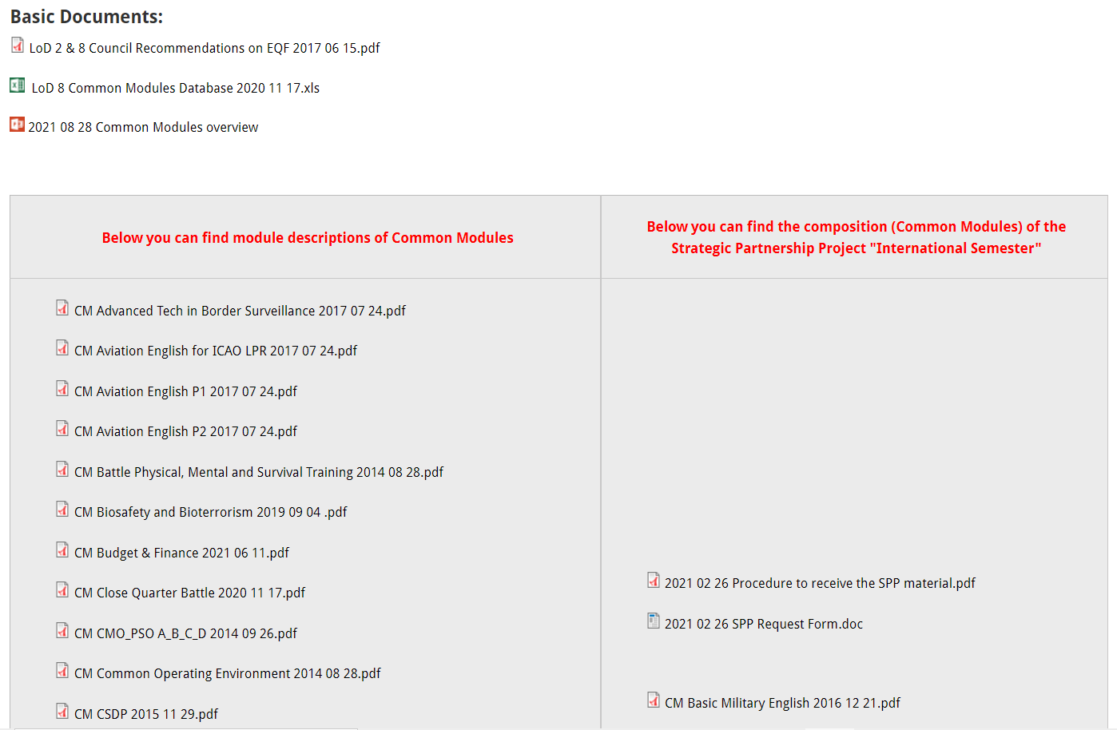
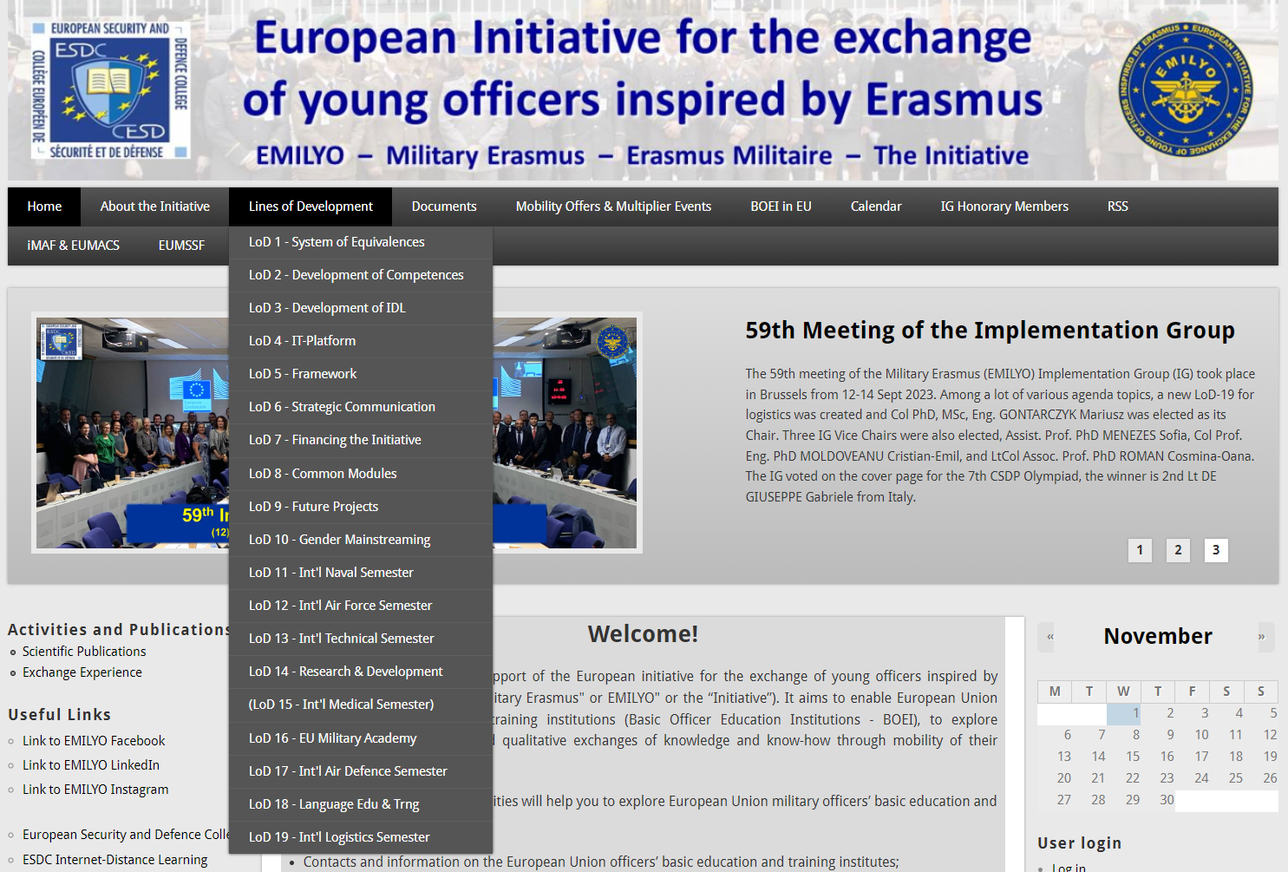
What are we doing?
Achievements ➔ Lines of Development
+ ESDC e-learning!
Erasmus Blended Intensive Programme
All the learning material
e-books
e-learning
ppt-slides
tests
etc.
is already elaborated and can be used for free

Slide 19
What are we doing?
Achievements ➔ Lines of Development
LoD No. | LoD Name | Solved | On-going
1 | System of Equivalences | R
2 | Development of Competences | R | S
3 | Development of IDL/e-learning | R | S
4 | Create an IT-Platform (www.emilyo.eu) | R
5 | (Legal) Framework | R | S
6 | Strategic Communication | R | S
7 | Financing the Initiative | R | S
8 | Common Modules | R | S
9 | Future Projects | R | S
10 | Gender Mainstreaming | R | S
11 | International Naval Semester |  | S
12 | International Air Force Semester | R
13 | International Technical Semester | R | S
14 | Research & Development |  | S
15 | International Medical Semester
16 | European Union Military Academy |  | S
17 | International Air Defence Semester |  | S
18 | Language Education & Training |  | S
19 | International Logistics Semester |  | S

Slide 20

What are we doing?
Achievements ➔ Lines of Development
Information to / during ….
EUMC (your ChoDs)
Defence Policy Directors
annual letter to Commandants
& Superintendents
EUMACSs (all services)
iMAFs (all services)
CSDP Olympiads
other conferences
(e.g.: EUAFA)
bilateral basis on request
European Parliament
ISOMA (Qatar)
Strategic Communication Plan
… publications ➔ ➔
⬅ ⬅

Slide 21
What are we doing?
Achievements ➔ Lines of Development
LoD No. | LoD Name | Solved | On-going
1 | System of Equivalences | R
2 | Development of Competences | R | S
3 | Development of IDL/e-learning | R | S
4 | Create an IT-Platform (www.emilyo.eu) | R
5 | (Legal) Framework | R | S
6 | Strategic Communication | R | S
7 | Financing the Initiative | R | S
8 | Common Modules | R | S
9 | Future Projects | R | S
10 | Gender Mainstreaming | R | S
11 | International Naval Semester |  | S
12 | International Air Force Semester | R
13 | International Technical Semester | R | S
14 | Research & Development |  | S
15 | International Medical Semester
16 | European Union Military Academy |  | S
17 | International Air Defence Semester |  | S
18 | Language Education & Training |  | S
19 | International Logistics Semester |  | S

Slide 22













What are we doing?
Achievements ➔ Lines of Development
How to finance?
  ERASMUS+ exchange rules (cadets, lecturers, staff)
  ERASMUS+ Strategic Partnership Projects
  LoD 5 Framework
    developed by lawyers
    just 10+2 countries opted in
  iMAF 2016
    book
    (how to use external funds) ➔ ➔
  ESDC co-financing
  Institutions‘ (military) budget

Slide 23

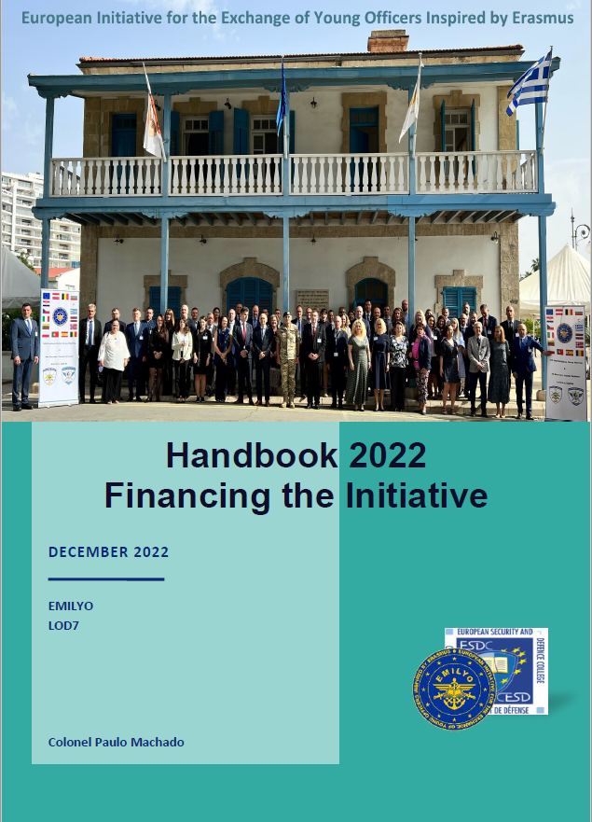
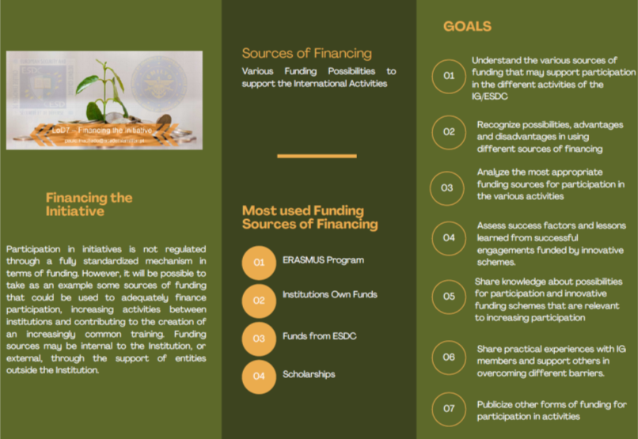
What are we doing?
Achievements ➔ Lines of Development

Slide 24
What are we doing?
Achievements ➔ Lines of Development
LoD No. | LoD Name | Solved | On-going
1 | System of Equivalences | R
2 | Development of Competences | R | S
3 | Development of IDL/e-learning | R | S
4 | Create an IT-Platform (www.emilyo.eu) | R
5 | (Legal) Framework | R | S
6 | Strategic Communication | R | S
7 | Financing the Initiative | R | S
8 | Common Modules | R | S
9 | Future Projects | R | S
10 | Gender Mainstreaming | R | S
11 | International Naval Semester |  | S
12 | International Air Force Semester | R
13 | International Technical Semester | R | S
14 | Research & Development |  | S
15 | International Medical Semester
16 | European Union Military Academy |  | S
17 | International Air Defence Semester |  | S
18 | Language Education & Training |  | S
19 | International Logistics Semester |  | S

Slide 25
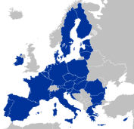














Common Module
What is it?
Request comments
from 65 BOEI (or MOD)
Proposed
Module
Cultural
Awareness
(2 ECTS)
Proposed
Module
Electronic
Warfare
(2 ECTS)
Proposed
Module
Fighting in
Build-Up Areas
(3 ECTS)
IG + LoD 2+8 Chairmen
pre-check:
Strategy
Goal-correctness
Learning Outcomes
acc. to SQF MILOF + EQF
ECTS correctness
(law, regulations)
Strategic Partnership
Implementation Group
BOEI Representatives
~ 80 Education
Experts
5 BOE
Institutions
Experts from
BOEI & MOD
Implemen-
tation
(national
Curricula)
Regular
adjustment(s)
see:
http://www.emilyo.eu/node/988
Approved
Common
Module
XXXX
(X ECTS)
External Evaluation?
Internal Quality
Assurance System

Slide 26
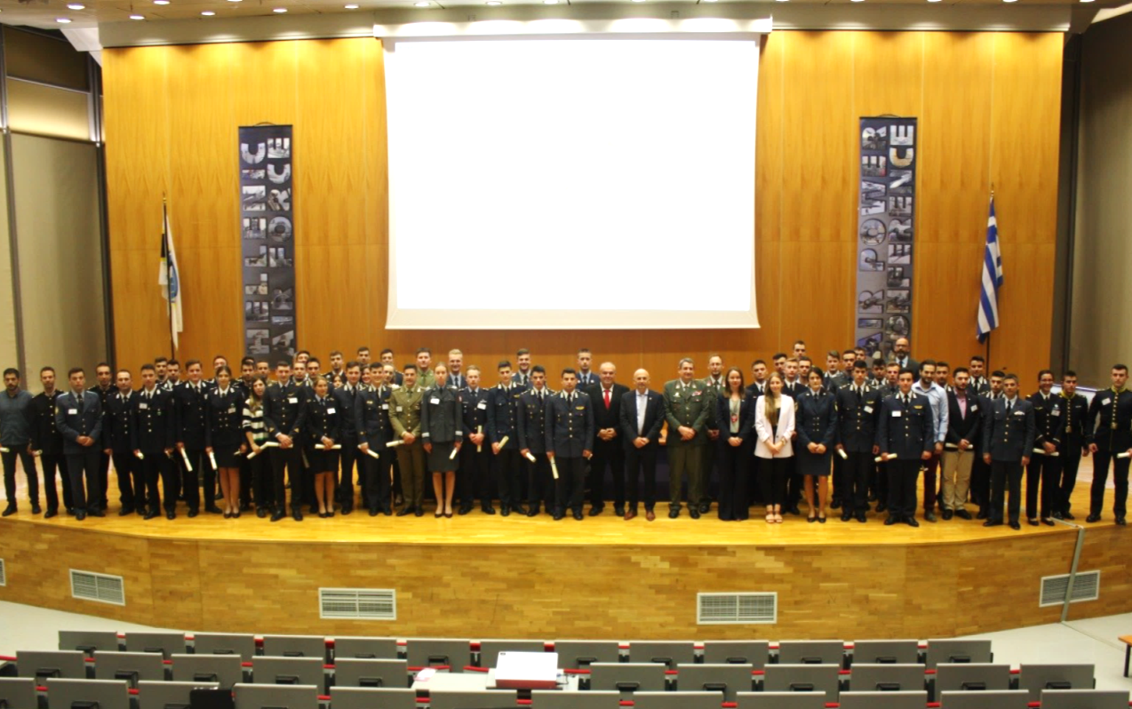
What are we doing?
Achievements ➔ Lines of Development
Common Module | ECTS |  | Common Module | ECTS
Advanced Technologies in Borders Surveillance | 2 |  | IMINT-GEOINT Analysis Course | 2
Aviation English for ICAO LPR | 3 |  | Individual Personal Development and Meta-Communication | 2
Aviation English P1 | 3 |  | Interoperability | 6
Aviation English P2 | 3 |  | Irregular Warfare | 3
Basic Military English | 2 |  | Law of Armed Conflict | 2
Battle Physical, Mental and Survival Training | 3 |  | Leadership & Agility in Complex Environments | 2
Biosafety and Bioterrorism | 2 |  | Leadership in Communication – IMLA | 2
Budget & Finance in EU Defence | 2 |  | Leadership, Motivation and Influence – IMLA | 2
Close Quarter Battle | 3 |  | Maritime Leadership | 2
Common Operating Environment | 3 |  | Maritime Security | 2
Common Security and Defence Policy | 2 |  | Military Ethics (A) | 2
Comprehensive Approach | 4 |  | Military Ethics (B) | 2
CMO/PSO (4 Sub-Modules [A, B, C, D]) | 12 |  | Military Instructor Training | 3
Crisis Management (Military Leadership) – IMLA | 2 |  | Military Leadership (A) | 2
Crises Management Operations (CMO) | 3 |  | Military Leadership (B) | 2
Cross Cultural Communication | 2 |  | Military Leadership (C) | 4
CSDP-Olympiad | 2 |  | Military Strategy and Security in the Baltic Sea Region | 3
Cultural Awareness | 2 |  | Senior Cadets’ Seminar on Leadership | 1.5
Cyber Security | 2 |  | Small Unit Tactics | 4
Defence and Security Economics | 4 |  | Social Engineering Protection | 2
Digital Leadership | 3 |  | Space Applications for Security and Defence | 2
Electronic Warfare | 2 |  | Stress Management – IMLA | 2
English for Aircraft Maintenance SET P1 | 3 |  | Troop Leading Procedures | 1
English for Aircraft Maintenance SET P2 | 3 |  | Technologies in Cyber Security | 2
English for Aircraft Maintenance SET P3 | 3 |  | Unmanned Aerial Systems | 2
English for Aviation Security Personnel | 3 |  | Winter Warfare Basic Module | 2
Fighting In Built Up Area | 3 |  | (NCN/Intern) Aerospace Technology (PL / MUT) | (8)
Gender Perspectives in Security and Defence | 2 |  | (NCM/Intern) Armament and Missile Technology (PL / MUT) | (8)
How to meet the Media | 2 |  | Total: 55 | 146.5

Slide 27
What are we doing?
Achievements ➔ Lines of Development
LoD No. | LoD Name | Solved | On-going
1 | System of Equivalences | R
2 | Development of Competences | R | S
3 | Development of IDL/e-learning | R | S
4 | Create an IT-Platform (www.emilyo.eu) | R
5 | (Legal) Framework | R | S
6 | Strategic Communication | R | S
7 | Financing the Initiative | R | S
8 | Common Modules | R | S
9 | Future Projects | R | S
10 | Gender Mainstreaming | R | S
11 | International Naval Semester |  | S
12 | International Air Force Semester | R
13 | International Technical Semester | R | S
14 | Research & Development |  | S
15 | International Medical Semester
16 | European Union Military Academy |  | S
17 | International Air Defence Semester |  | S
18 | Language Education & Training |  | S
19 | International Logistics Semester |  | S

Slide 28

What are we doing?
Achievements ➔ Lines of Development
Sep 2018
1st E⁺ Gender
Seminar (AT)
Oct 2019
2nd E⁺ Gender
Seminar (BG)
Mar 2021
3rd E⁺ Gender
Seminar (EE)
May 2022
4th E⁺ Gender
Seminar (CY)
Jun 2023
PT: 5th E⁺ Gender
Seminar + ME (MGS)
+ Common Module
2020 ➔
LoD-10 subgroup
meetings
Analysing good practices
Dec 2020
(2020-2023)
SPP Military Gender Studies
2021-2022
MGS Project
development
Content of new CM (syllabus preparation
and reviews, learning materials, etc.)
Nov 2022
1st Common Module (pilot)
Austria/TMA
Nov 2018
NEW!
LoD-10 Gender
Mainstreaming
Feb 2019
Gender Education Questionnaire
Collecting data (in progress)
scientific reports
Partners:
PT – PMA (coordinator)
BG – NMU
IT – UoT
RO – LFA

Slide 29
What are we doing?
Achievements ➔ Lines of Development
LoD No. | LoD Name | Solved | On-going
1 | System of Equivalences | R
2 | Development of Competences | R | S
3 | Development of IDL/e-learning | R | S
4 | Create an IT-Platform (www.emilyo.eu) | R
5 | (Legal) Framework | R | S
6 | Strategic Communication | R | S
7 | Financing the Initiative | R | S
8 | Common Modules | R | S
9 | Future Projects | R | S
10 | Gender Mainstreaming | R | S
11 | International Naval Semester |  | S
12 | International Air Force Semester | R
13 | International Technical Semester | R | S
14 | Research & Development |  | S
15 | International Medical Semester
16 | European Union Military Academy |  | S
17 | International Air Defence Semester |  | S
18 | Language Education & Training |  | S
19 | International Logistics Semester |  | S

Slide 30
What are we doing?
Achievements ➔ Lines of Development
Deadlines:
February 2023 – syllabuses approval, working group development, start of course development
March 2023 – project submission for INS
September 2023 – course content development
October 2023 – submit the final modules offer for each partner
SPP Partners ➔ ongoing process
RO – RNA (coordinator)
BG – BNA
GR – HNA
IT – ITNA
PL – PNA

Slide 31
What are we doing?
Achievements ➔ Lines of Development
Naval Leadership – Polish Naval Academy (Hellenic Naval Academy)
Power Plants – Italian Naval Academy (Romanian Naval Academy)
Computer Network – Polish Naval Academy (Romanian Naval Academy)
Naval Electronics – Hellenic Naval Academy (Italian Naval Academy)
Naval Sensors – Italian Naval Academy (Hellenic Naval Academy)
Maritime Security – Bulgarian Naval Academy (Polish Naval Academy)
Naval Cyber Threats – Bulgarian Naval Academy (Italian Naval Academy)
Oceanography – Romanian Naval Academy
Naval Architecture – Romanian Naval Academy
Naval Communication – Hellenic Naval Academy/ Romanian Naval Academy
Common Security and Defence Policy

Slide 32
What are we doing?
Achievements ➔ Lines of Development
LoD No. | LoD Name | Solved | On-going
1 | System of Equivalences | R
2 | Development of Competences | R | S
3 | Development of IDL/e-learning | R | S
4 | Create an IT-Platform (www.emilyo.eu) | R
5 | (Legal) Framework | R | S
6 | Strategic Communication | R | S
7 | Financing the Initiative | R | S
8 | Common Modules | R | S
9 | Future Projects | R | S
10 | Gender Mainstreaming | R | S
11 | International Naval Semester |  | S
12 | International Air Force Semester | R
13 | International Technical Semester | R | S
14 | Research & Development |  | S
15 | International Medical Semester
16 | European Union Military Academy |  | S
17 | International Air Defence Semester |  | S
18 | Language Education & Training |  | S
19 | International Logistics Semester |  | S

Slide 33

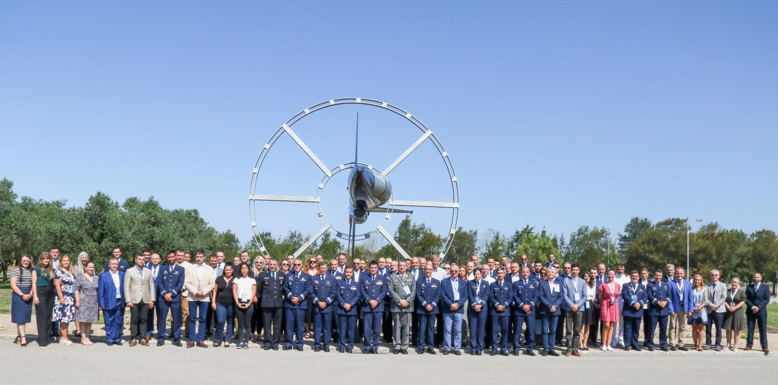
What are we doing?
Achievements ➔ Lines of Development
2022 | 2023 | 2024
GR – HAFA | PL – PAFU | BG – BAFA
PT – PTAFA | ? | ?
RO – HCAFA
Sintra
Portugal
20 September 2022

Slide 34
What are we doing?
Achievements ➔ Lines of Development
Module name | ECTS | Responsibility
Cyber Warfare | 2 | HAFA
Military Ethics | 2 | HAFA
Common Security & Defence Policy | 2 | HAFA
Space Applications for Security and Defence | 2 | HAFA
Aviation Meteorology | 2 | AFAHC
Flight & Ground Safety | 2 | PTAFA
Aviation English | 4 | AFAHC
Aerial Navigation | 2 | AFAHC
Avionics Systems | 4 | PTAFA
Propulsion Systems | 2 | PTAFA
Total | 24
National Requirements | 6
6 new common modules (process of “common” open)

Slide 35
What are we doing?
Achievements ➔ Lines of Development
LoD No. | LoD Name | Solved | On-going
1 | System of Equivalences | R
2 | Development of Competences | R | S
3 | Development of IDL/e-learning | R | S
4 | Create an IT-Platform (www.emilyo.eu) | R
5 | (Legal) Framework | R | S
6 | Strategic Communication | R | S
7 | Financing the Initiative | R | S
8 | Common Modules | R | S
9 | Future Projects | R | S
10 | Gender Mainstreaming | R | S
11 | International Naval Semester |  | S
12 | International Air Force Semester | R
13 | International Technical Semester | R | S
14 | Research & Development |  | S
15 | International Medical Semester
16 | European Union Military Academy |  | S
17 | International Air Defence Semester |  | S
18 | Language Education & Training |  | S
19 | International Logistics Semester |  | S

Slide 36

What are we doing?
Achievements ➔ Lines of Development
Jun 2021
Pilot Events
Syllabus Preparation (in progress)
MUT (Jun 2023)
MTA (Apr 2023)
HAFA (Feb 2023)
FAFA (Oct 2022)
NMU (Sep 2022)
syllabus preparation (Sept. 2021)
syllabus finalisation (Dec. 2021)
Curriculum design
Teaching Materials & E-learning platform
Selection of subjects (April)
Curriculum finalisation (September)
First draft (Feb 2022)
Finalisation (Nov 2022)
Dec 2020
Sep 2021
May 2023
last
SPP ME
SPP Partners:
RO – MTA
(coordinator)
BG – NMU
FR – FASFA
GR – HAFA
PL – MUT
E_{U}CTS_{DS}
Implementation

Slide 37
What are we doing?
Achievements ➔ Lines of Development
Module name | ECTS | Responsibility
Applied Informatics Applied Automation for Eng. Systems | 3 3 | MTA
Integrated Weapon Systems CSDP for Technical Systems | 3 3 | FASFA
Computer Networks Programming Languages Signal Processing Microcontrollers | 3 3 3 3 | NMU
Propulsion Systems Dynamic of Flight Mechanics and Material Science CAD and Numerical Analysis | 3 3 3 3 | MUT
Interdisciplinary Scientific Project | 6 | HAFA
Total | 42
13 new common modules – process for status “common” on-going
Electronic & IT option
Mec. & Aero. option

Slide 38
What are we doing?
Achievements ➔ Lines of Development
LoD No. | LoD Name | Solved | On-going
1 | System of Equivalences | R
2 | Development of Competences | R | S
3 | Development of IDL/e-learning | R | S
4 | Create an IT-Platform (www.emilyo.eu) | R
5 | (Legal) Framework | R | S
6 | Strategic Communication | R | S
7 | Financing the Initiative | R | S
8 | Common Modules | R | S
9 | Future Projects | R | S
10 | Gender Mainstreaming | R | S
11 | International Naval Semester |  | S
12 | International Air Force Semester | R
13 | International Technical Semester | R | S
14 | Research & Development |  | S
15 | International Medical Semester
16 | European Union Military Academy |  | S
17 | International Air Defence Semester |  | S
18 | Language Education & Training |  | S
19 | International Logistics Semester |  | S

Slide 39
What are we doing?
Achievements ➔ Lines of Development
2023
Feb 2024
Put in place a consortium to develop tools and processes to communicate research and strengthen the network of researchers.
61st IG meeting:
Scientific
conference
Foundation.
First common thesis decided to run in parallel between HAFA and MUT.
60th IG meeting:
Preparing
scientific
conference.
Sep 2020
2021-2022
Nov 2023
On going actions:
Publish scientific conferences on the EMILYO website
R & D conference during 61st IG meeting in Bucharest

Slide 40
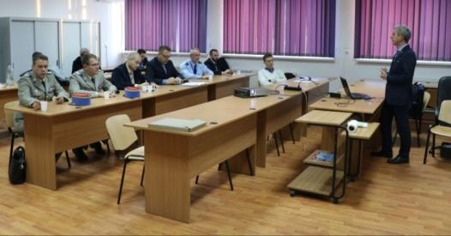
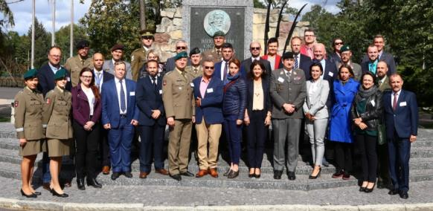
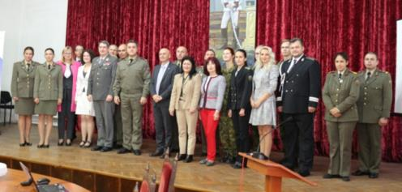
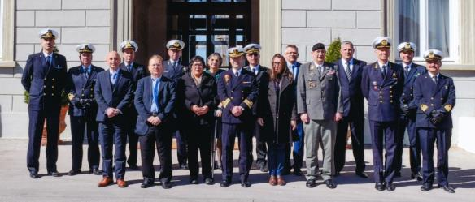
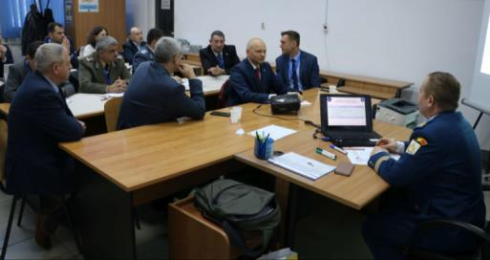
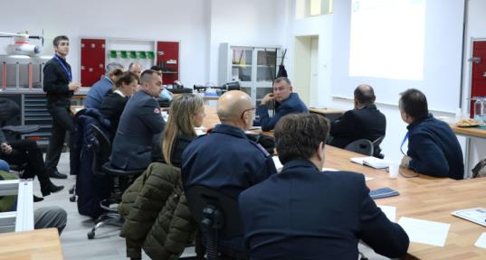
What are we doing?
Meetings/Projects dedicated to the Initiative (LoDs)

Slide 41

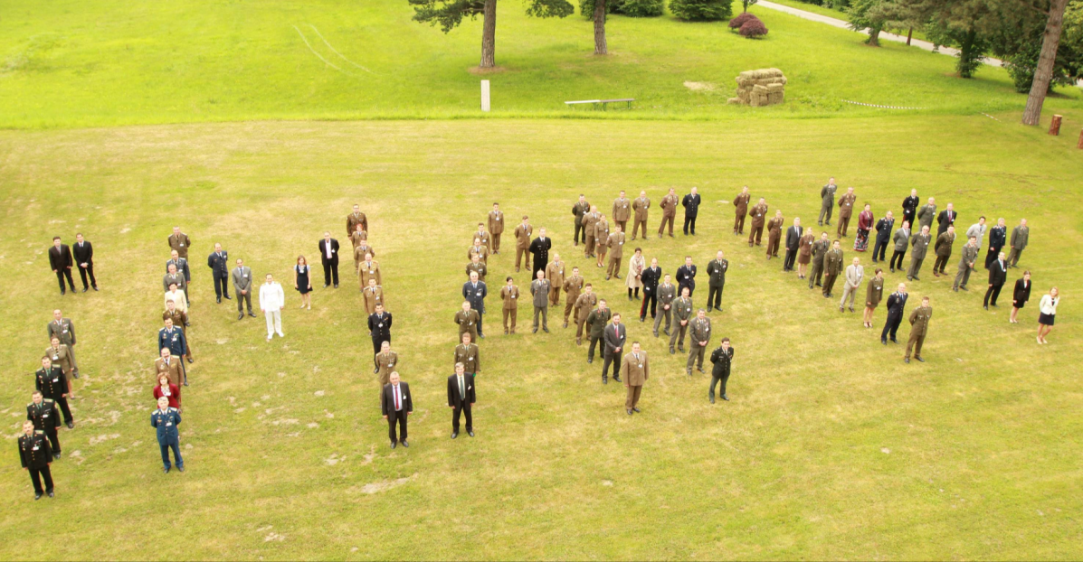
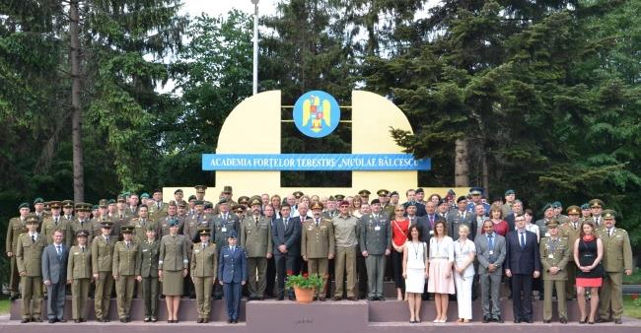
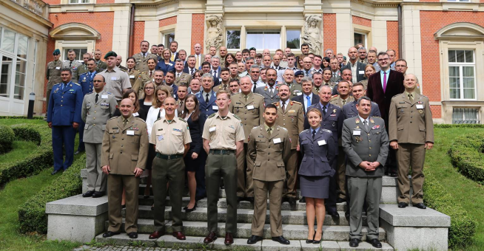
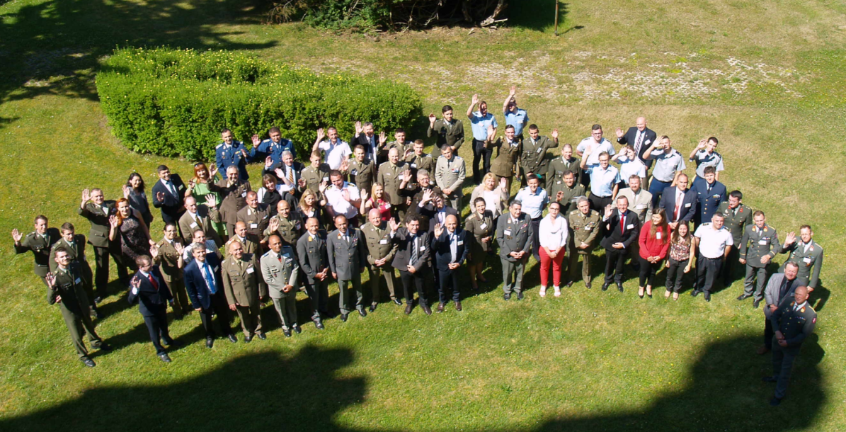
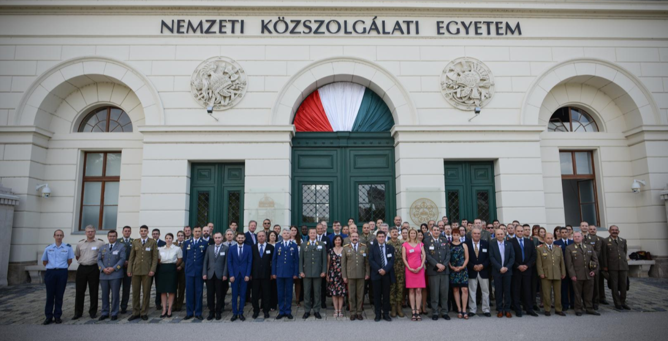
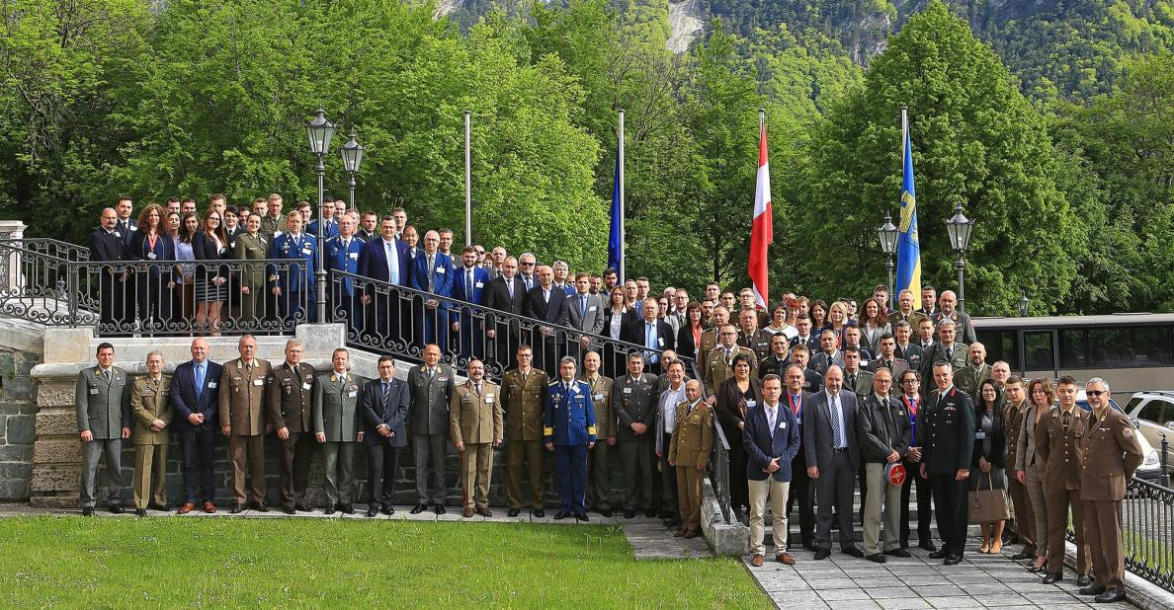
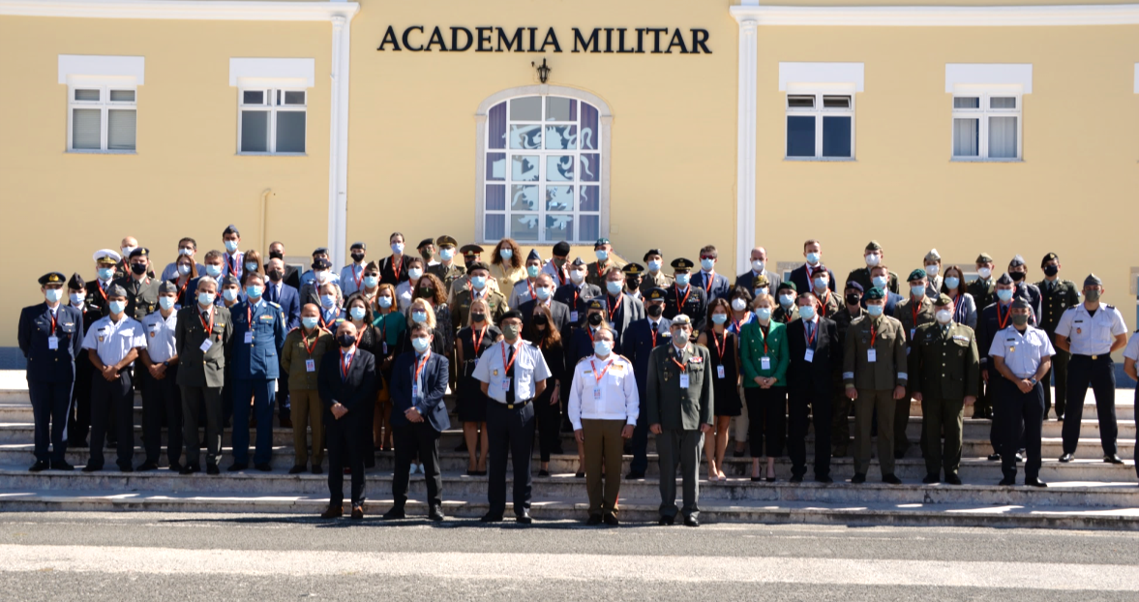
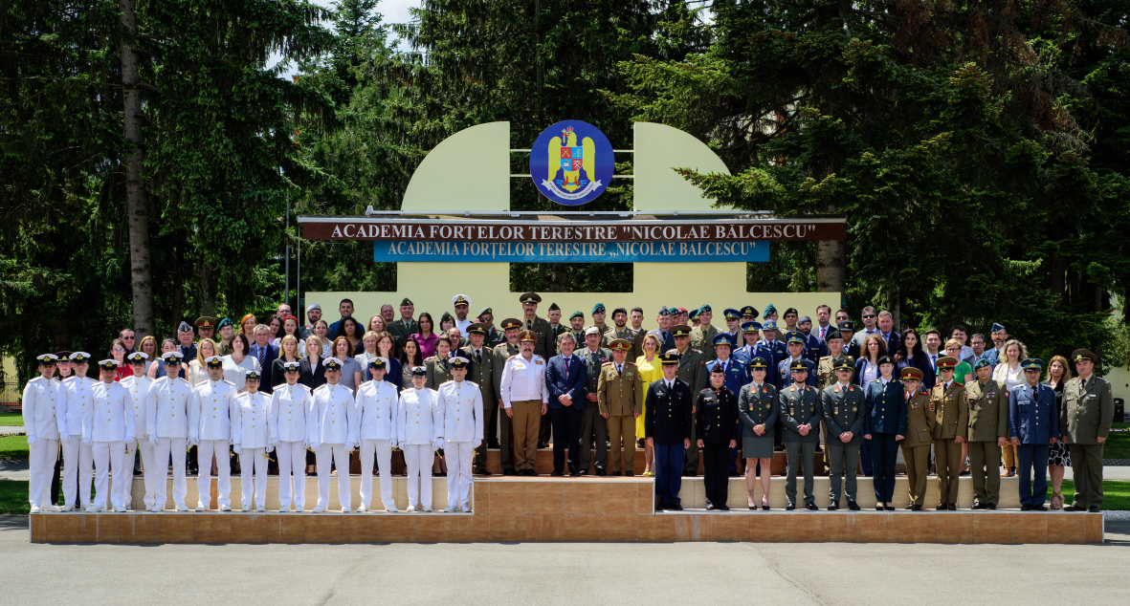
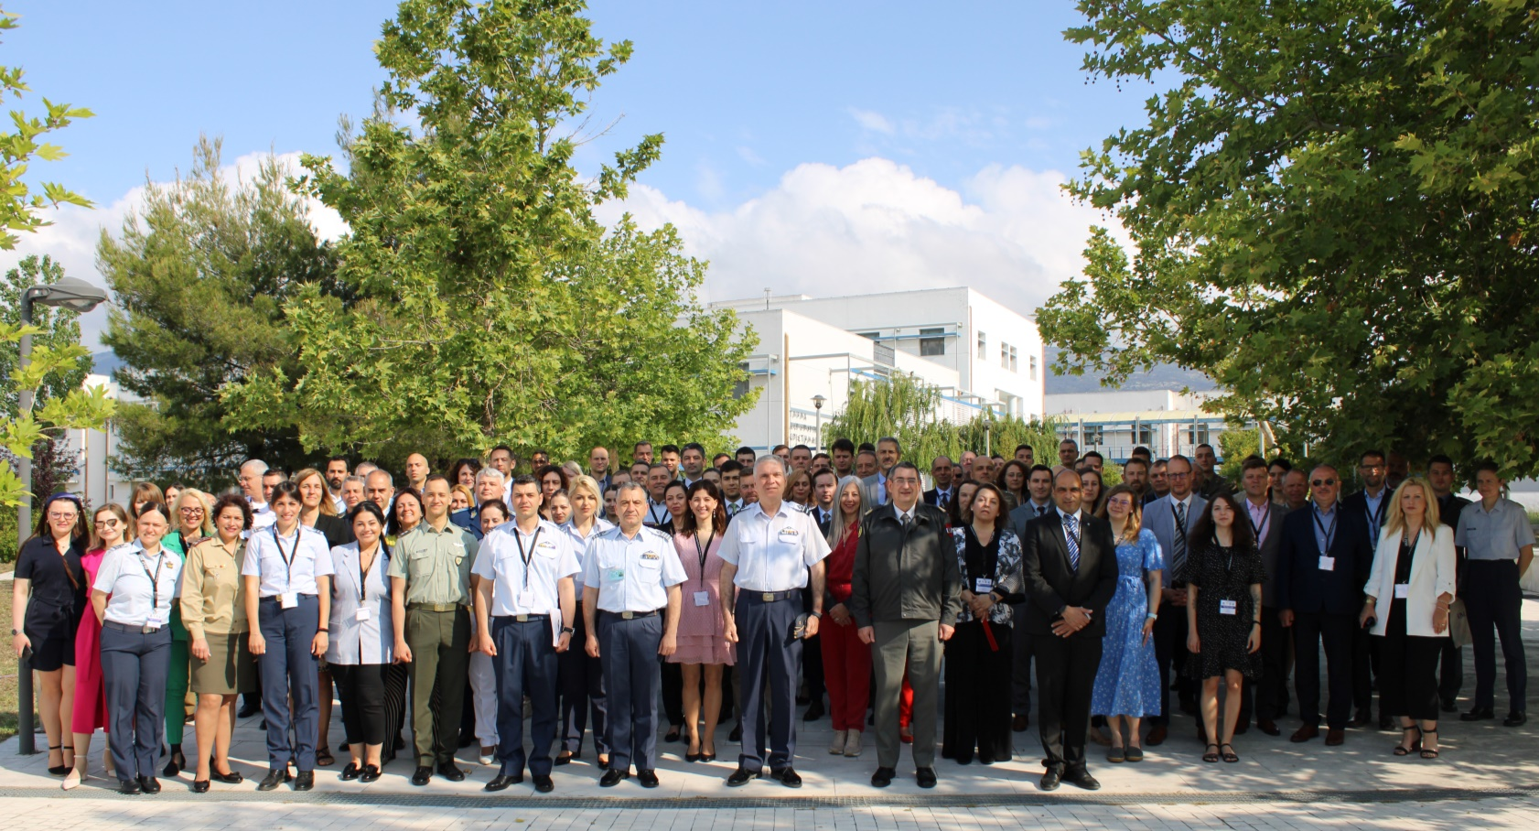
What are we doing?
Meetings/Projects dedicated to the Initiative (iMAF)
2015: Romania
2014: Austria
2013: Austria
2016: Poland
2017: Czech Republic
2019: Austria
2021: Portugal
2023: Greece
2022: Romania
2018: Hungary

Slide 42

Who is involved in iMAF?
New agreement in 2021 – all (22 +3) signed in 2022
+1 in 2023
You are most welcome to join!

Slide 43
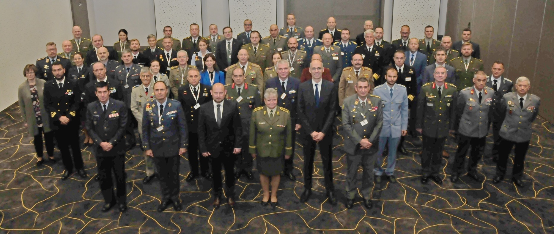
What are we doing?
Meetings dedicated to the Initiative (EUMACS)
All Services!
Last EUMACS:
12-14 Oct 2022 at the University of Defence in Brno

Slide 44
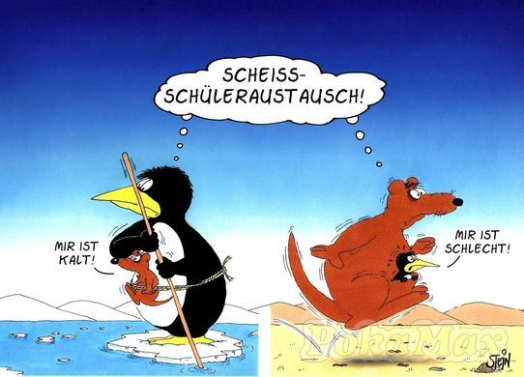
Cui bono?
Why
we conduct this stupid
exchanges ???
Why
we conduct this stupid
exchanges ???
I
feel
cold
I
feel
sick
Source: http://debeste.de/16253/Sch-leraustausch ; re-shaped by Col Gell

Slide 45
Cui bono?
need for financial investments
increased administration
Why
we conduct this stupid
exchanges ???
difficulties for recognition
of learning outcomes
language difficulties
cui bono
where to find
up-dated information
I
feel
cold
I
feel
sick
…. therefore, does it make
sense at all?

Slide 46
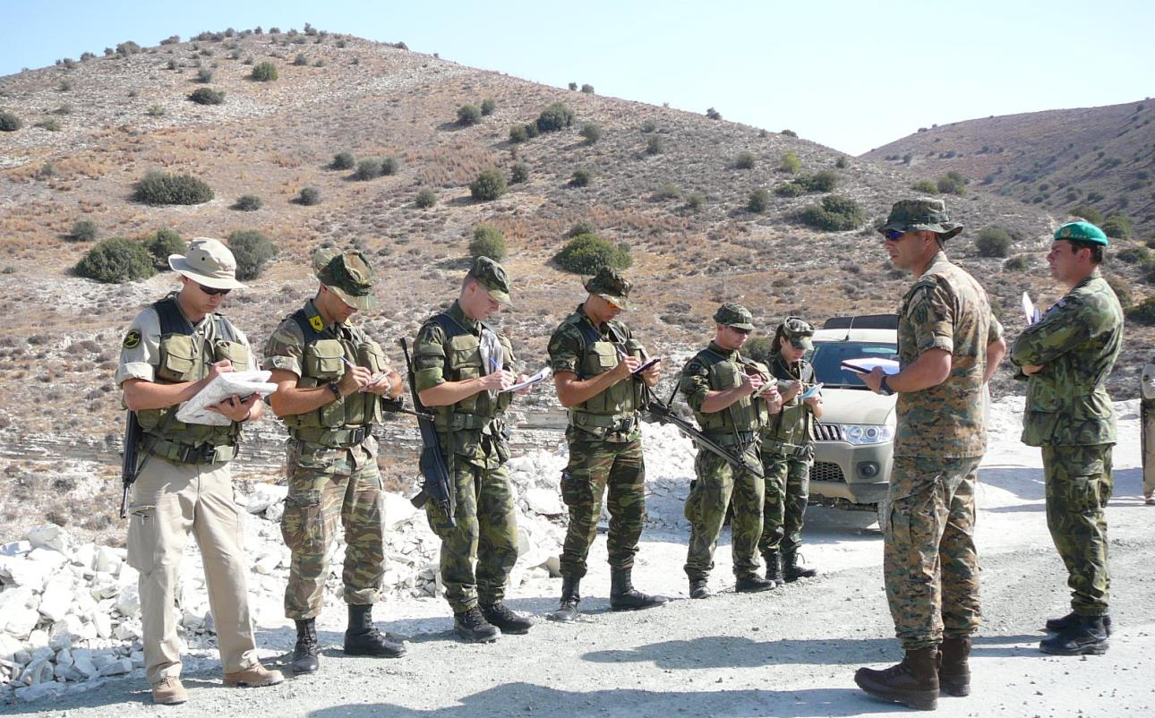
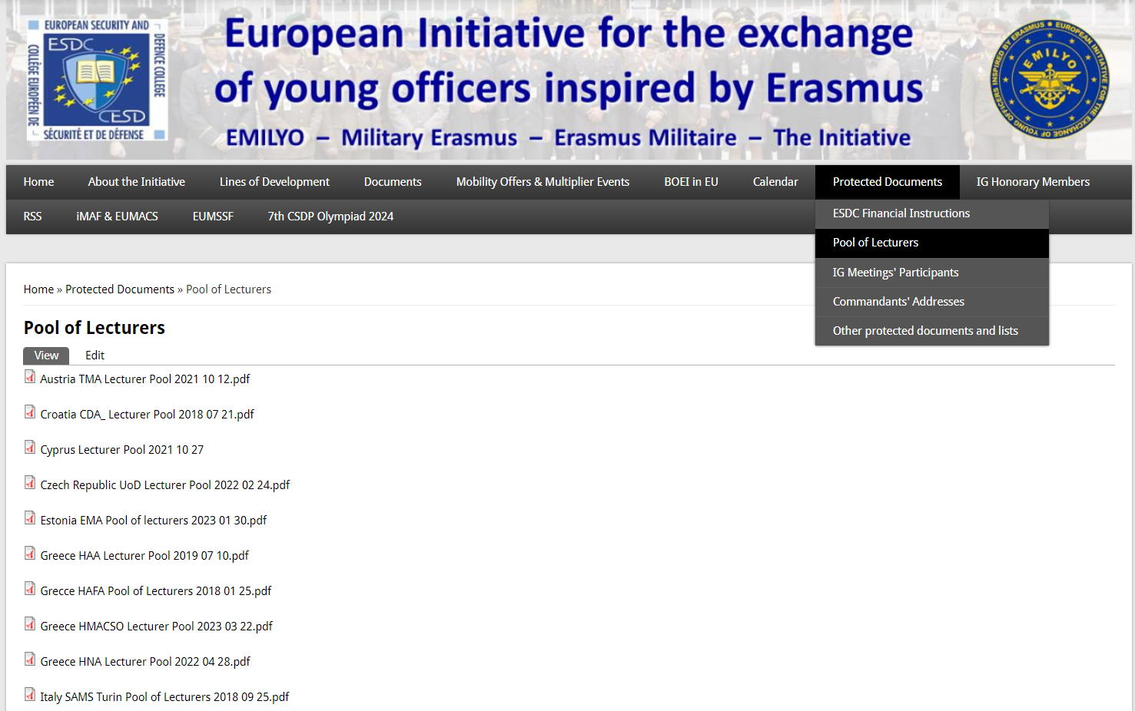
Cui bono?
Lecturers’/Instructors’/Educators’ Exchanges
Available on PW-protected area on www.emilyo.eu
share experiences
pass knowledge to other EU BOEIs

Slide 47
Conclusions based on a huge scientific Research (Habilitation)
The European Initiative
with its international activities
increases students’
(Officer Cadets’ / future leaders’)
skills & competencies
(special knowledge, personal development, metabolism, self-confidence …)
Available at: http://www.emilyo.eu/node/1203

Slide 48
Internationalisation
Some Statements for the WHY & HOW ….
What | Field | Programme
Formally | Academic (+ non-academic) | ERASMUS (1987).
Formally | Academic | Bologna Declaration (1999) and Leuven Communiqué (2009).
Formally | Academic + non-academic | Council conclusions by the European Union Ministers of Defence (2008).
Formally | Academic | National accreditation of academic programmes.
Scientifically | Academic + non-academic | Individual benefits for exchange Cadets / Midshipmen / Students.

Slide 49
Internationalisation
Some Statements for the WHY & HOW ….
Without strategy for internationalisation
➔ no accreditation.
You need a functional department to deal with all the necessary work (Erasmus+, internal military rules, budget, …) ➔ “International Office” with sufficient personnel incl. Erasmus coordinator(s).
The experienced IG members fully support the newcomers!
For those institutions, which depend on civilian universities: IG Chair + members support (e.g.: explaining common modules ➔ EQF).

Slide 50
Future Intent (Priorities)
ESDC Annual Report 2022-2023
Ensure that all Basic Officer Education Institutions of all Member States are involved in the European Initiative for the exchange of young officers inspired by Erasmus.
Review and update the existing Common Modules according to the SQF-MILOF guidelines and according to priorities and create new modules based on the most current requirements.
Every Basic Officer Education Institution should integrate at least one common module into its curriculum.
Implementation of the European Common Technical Semester on Defence and Security (EuCTSDS ) and launch of new projects for international semesters in the fields of Air Defence, Logistics, and Navy.
Reorganisation of the Implementation Group in accordance with the new Vice Chairs in order to maintain and ensure quality.

Slide 51





(Future) Intent
EUMACS 2022 Proposals
Commandants‘ / Superintendents‘ requests in October 2022 | Status
Train the Trainers in English (new LoD).
New Common Module on information awareness.
Identification of and collaboration with potential NATO research projects.
Sources: https://www.pinterest.de/pin/803048177291560920/?amp_client_id=CLIENT_ID%28_%29&mweb_unauth_id=%7B%7Bdefault.session%7D%7D&amp_url=https%3A%2F%2Fwww.pinterest.de%2Famp%2Fpin%2F803048177291560920%2F&open_share=t. [1-11-23].
https://www.123rf.com/photo_13097340_two-different-directions.html. [1-11-23].

Slide 52
Kind Requests (1)
Opt-in the LoD-5 Framework
= Countries, which
already opted-in.
= bilateral agreement
between 2 institutions.
The document is
available at:
http://www.emilyo.eu/node/982

Slide 53
Kind Requests (2)
Providing LoD-Chair(s) for unoccupied LoDs
No. | LoD Name | Chairperson | BOEI
1 | System of Equivalences | (Col Assoc. Prof. GELL Harald, PhD) | AT-TMA
2 | Development of Competences | Capt (N) Assoc. Prof. DIMITROV Nedko, PhD | BG-NVNA
3 | Development of e-learning | (Col Assoc. Prof. GELL Harald, PhD) | AT-TMA
4 | Create an IT-Platform | (Col Assoc. Prof. GELL Harald, PhD) | AT-TMA
5 | (Legal) Framework | (Col Assoc. Prof. GELL Harald, PhD) | AT-TMA
6 | Strategic Communication | ? Maj TSANAKAS Konstantinos ? | ? GR-HAFA ?
7 | Financing the Initiative | Col MACHADO Paulo, MSc | PT-PMA
8 | Common Modules | Assoc. Prof. KARADIMAS Nikolaos V., PhD | GR-HAA
9 | Future Projects | Assoc. Prof. WINCEWICZ-BOSY Marta, PhD | PL-AWL
10 | Gender Mainstreaming | Col Assoc. Prof. ATANASOVA-KRASTEVA Nevena, PhD | BG-NDU
11 | International Naval Semester | Col Assoc. Prof. POPA Catalin, PhD | RO-RNA
12 | International Air Force Semester | Assist. Prof. KARAMPELAS Panagiotis, PhD | GR-HAFA
13 | International Technical Semester | Col Prof. Eng. MOLDOVEANU Cristian Emil, PhD | RO-MTA
14 | Research & Development | Assoc. Prof. TEMPLALEXIS Ioannis, PhD | GR-HAFA
15 | International Medical Semester | frozen
16 | EU Military Academy (CJS) | (Col Assoc. Prof. GELL Harald, PhD) | AT-TMA
17 | Int’l Air Defence Semester | Col Assoc. Prof. GHERMAN Laurian, PhD | RO-HCAFA
18 | Language Education & Training | Col (GS) Doc. Ing. HOLCNER Vladan, PhD | CZ-UoD
19 | International Logistics Semester | Col Eng. GONTARCZYK Mariusz, PhD, MSc | PL-MUT

Slide 54
Kind Requests (3)
Implement at least 1 Common Module (1 week)
Common Module | ECTS |  | Common Module | ECTS
Advanced Technologies in Borders Surveillance | 2 |  | IMINT-GEOINT Analysis Course | 2
Aviation English for ICAO LPR | 3 |  | Individual Personal Development and Meta-Communication | 2
Aviation English P1 | 3 |  | Interoperability | 6
Aviation English P2 | 3 |  | Irregular Warfare | 3
Basic Military English | 2 |  | Law of Armed Conflict | 2
Battle Physical, Mental and Survival Training | 3 |  | Leadership & Agility in Complex Environments | 2
Biosafety and Bioterrorism | 2 |  | Leadership in Communication – IMLA | 2
Budget & Finance in EU Defence | 2 |  | Leadership, Motivation and Influence – IMLA | 2
Close Quarter Battle | 3 |  | Maritime Leadership | 2
Common Operating Environment | 3 |  | Maritime Security | 2
Common Security and Defence Policy | 2 |  | Military Ethics (A) | 2
Comprehensive Approach | 4 |  | Military Ethics (B) | 2
CMO/PSO (4 Sub-Modules [A, B, C, D]) | 12 |  | Military Instructor Training | 3
Crisis Management (Military Leadership) – IMLA | 2 |  | Military Leadership (A) | 2
Crises Management Operations (CMO) | 3 |  | Military Leadership (B) | 2
Cross Cultural Communication | 2 |  | Military Leadership (C) | 4
CSDP-Olympiad | 2 |  | Military Strategy and Security in the Baltic Sea Region | 3
Cultural Awareness | 2 |  | Senior Cadets’ Seminar on Leadership | 1.5
Cyber Security | 2 |  | Small Unit Tactics | 4
Defence and Security Economics | 4 |  | Social Engineering Protection | 2
Digital Leadership | 3 |  | Space Applications for Security and Defence | 2
Electronic Warfare | 2 |  | Stress Management – IMLA | 2
English for Aircraft Maintenance SET P1 | 3 |  | Troop Leading Procedures | 1
English for Aircraft Maintenance SET P2 | 3 |  | Technologies in Cyber Security | 2
English for Aircraft Maintenance SET P3 | 3 |  | Unmanned Aerial Systems | 2
English for Aviation Security Personnel | 3 |  | Winter Warfare Basic Module | 2
Fighting In Built Up Area | 3 |  | (NCN/Intern) Aerospace Technology (PL / MUT) | (8)
Gender Perspectives in Security and Defence | 2 |  | (NCM/Intern) Armament and Missile Technology (PL / MUT) | (8)
How to meet the Media | 2 |  | Total: 55 | 146.5

Slide 55
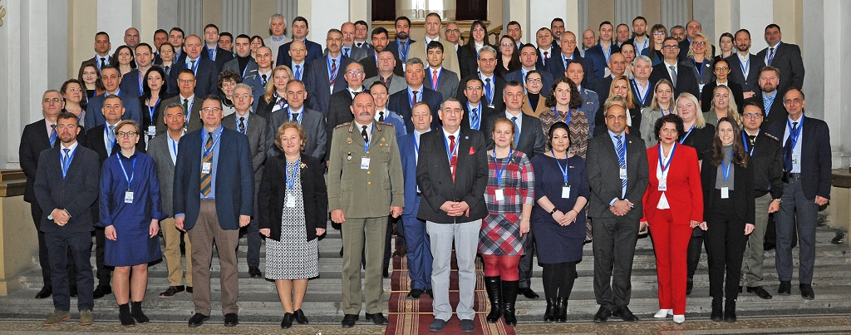
Kind Requests (4)
(Continue) sending Experts to the IG Meetings
By doing so, you assure your influence.
You are informed about everything concerning the BOE.
Experienced IG members support the “newcomers”.

Slide 56
Kind Requests (5)
You are invited to join the iMAF-Group
1 | EU | European Security and Defence College
2 | AT | Institute for Basic Officer Education at the Theresan Military Academy
3 | BG | Bulgarian Air Force Academy “Georgi Benkovski”
4 | BG | Rakovski National Defence College
5 | CZ | University of Defence
6 | GR | Hellenic Air Force Academy
7 | GR | Hellenic Army Academy
8 | GR | Hellenic Naval Academy
9 | GR | Hellenic Military Academy of Combat Support Officers
10 | HU | Faculty of Military Sciences and Officer Training at NUPS
11 | IT | Education & Training Command and School of Applied Military Studies
12 | LT | General Jonas Zemaitis Military Academy of Lithuania
13 | LV | National Defence Academy of Latvia
14 | NO | Norwegian Defence University College
15 | PL | Military University of Technology
16 | PL | General Tadeusz Kosciuszko Military University of Land Forces
17 | PT | Military Academy
18 | RO | “Henri Coandă” Air Force Academy
19 | RO | Military Technical Academy “Ferdinand I”
20 | RO | Romanian Naval Academy ”Mircea cel Batran”
21 | RO | “Nicolae Balcescu” Land Forces Academy
22 | SK | Armed Forces Academy of General Milan Rastislav Štefánik
23 | CY | Cyprus Security and Defence Academy
24 | BG | "Vasil Levski“ National Military University
25 | RO | „Carol I“ National Defence University
26 | GR | Hellenic Military Nursing Academy
14
13
12
15
1
16
5
22
2
10
18
21
19
20
11
25
4
3
24
17
9
6
7
8
26
23

Slide 57
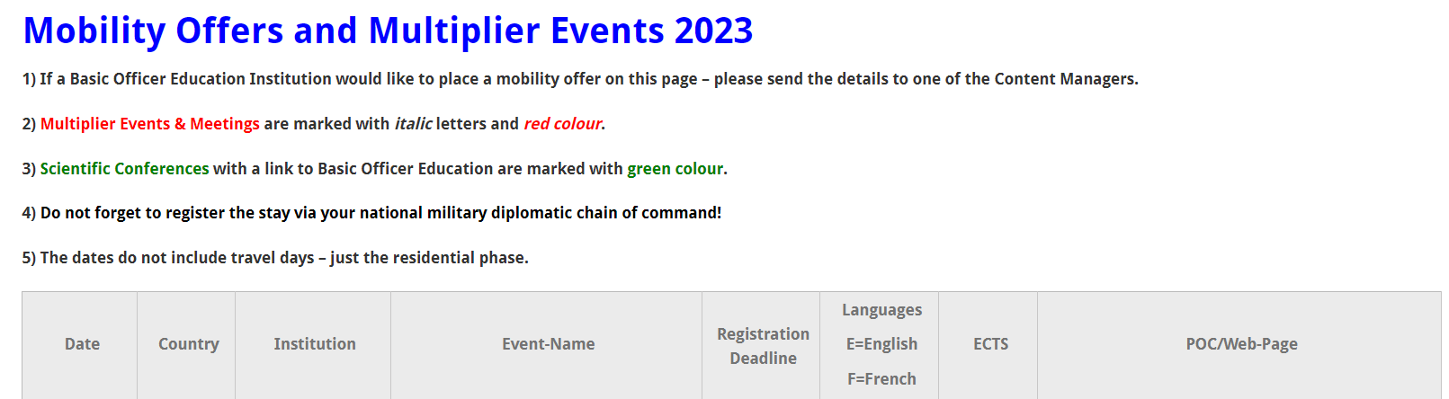
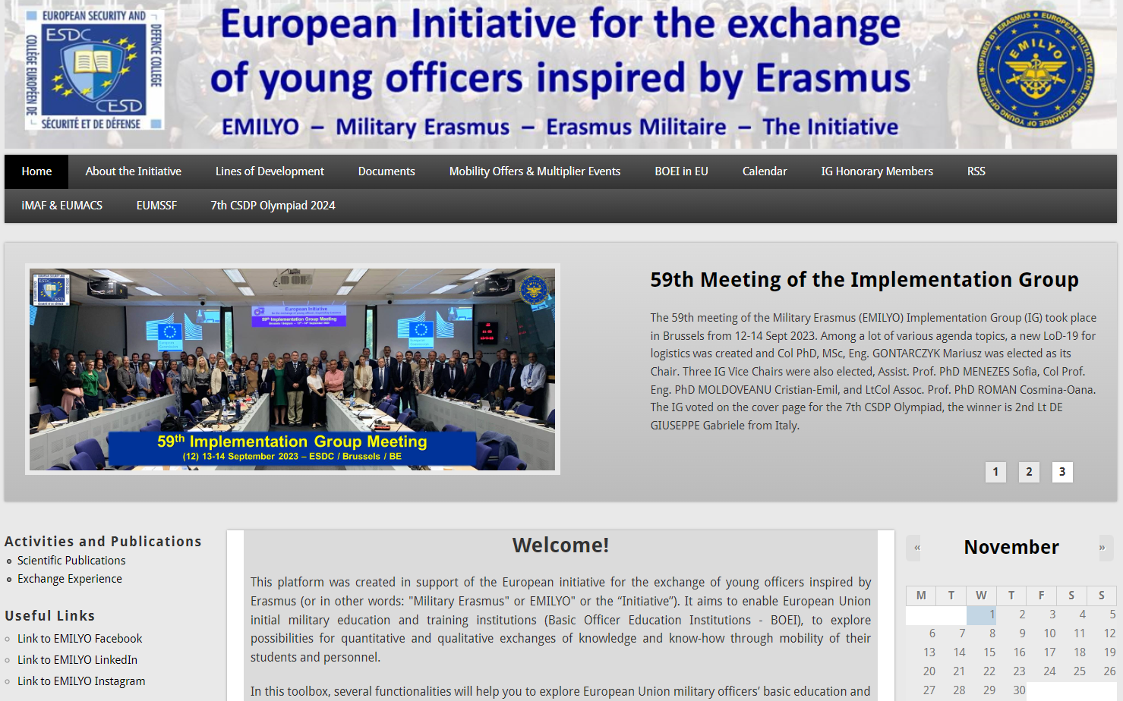
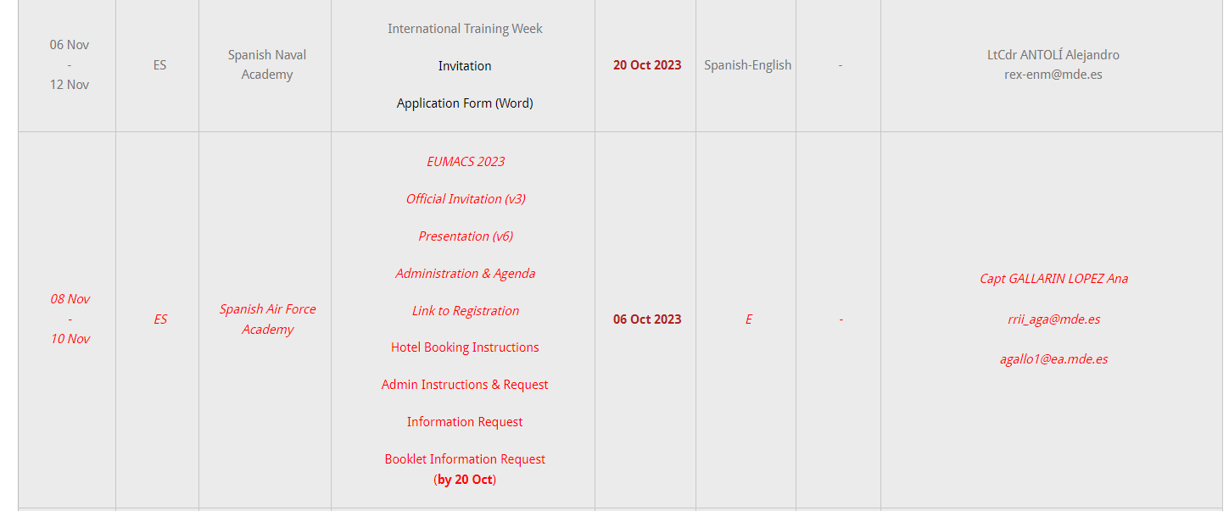
Further Information www.emilyo.eu

Slide 58
Summary
We act according to the decision of all (your) Ministers of Defence.
We use – whenever possible – external funds.
We promote a European Security and Defence Culture.
We depend on YOUR support.

Slide 59


Thank
YOU
for
YOUR
attention!

